Slide 1
Subject:Foundations of Data Science Unit 3:Data Collection and Preprocessing Ms.Ashwini M. Patil Dr.D.Y.Patil Arts,Commerce and Science College,Pimpri,Pune 18

Slide 2
Structured data
Structured data send to data that is organized and design in a specific way to make it easily readable and understand by both humans and machines. This is typically achieved through the use of a well-defined schema or data model, which provides a structure for the data.
For example, in a customer database, each record might contain fields for the customer's name, address, phone number, and email address. Structured data is highly valuable because it can be easily searched, queried, and analyzed using various tools and techniques.

Slide 3
Semi-structured data
Semi-structured data is data that does not reside in a traditional relational database (like SQL) but still has some organizational properties, such as tags or markers, that make it easier to analyze than completely unstructured data.
It doesn't follow a strict schema like structured data, but it still contains elements like labels or keys that make the data identifiable and searchable.

Slide 4
Unstructured data
Unstructured data refers to information that does not have a predefined format or structure. It is messy, unorganized and hard to sort. Unlike structured data, which is organized into rows and columns (like an Excel sheet), unstructured data comes in many different forms such as text documents, images, audio files, videos and social media posts. Because this type of data does not follow a clear pattern, it’s harder to store, process and search.

Slide 5
Data Sources
1. Open Data Open data refers to data that is freely available for anyone to access, use, and share. Governments, research institutions, and international organizations often publish open datasets to promote transparency, innovation, and public participation. These datasets are usually well-structured and include topics such as health, education, weather, and economics. Open data plays a vital role in research, policy-making, and data analysis by providing reliable and accessible information to the public.

Slide 6
2. Social Media Data
Social media data is generated by users on platforms like Twitter, Facebook, Instagram, YouTube, and LinkedIn. It includes a variety of formats such as text posts, comments, photos, videos, likes, shares, and hashtags. This type of data is unstructured and constantly evolving, making it both valuable and challenging to analyze. Businesses and researchers use social media data for sentiment analysis, trend detection, brand monitoring, and public opinion studies. However, due to its personal and informal nature, privacy and ethical considerations are crucial when using this data.
3. Multimodal Data
Multimodal data combines multiple types of data sources such as text, audio, images, video, and sensor readings. This kind of data provides a richer and more comprehensive understanding of complex systems and behaviors. For example, in healthcare, a diagnosis might involve patient reports (text), MRI scans (image), and doctor consultations (audio). In AI applications like self-driving cars, cameras, radar, and GPS data work together to detect and respond to the environment. Although powerful, multimodal data is complex to manage, requiring advanced tools for synchronization, processing, and interpretation.
4. Standard Datasets Standard datasets are publicly available, curated collections of data commonly used for academic research, benchmarking, and training machine learning models. These datasets are often domain-specific — such as IMDB for sentiment analysis in NLP, MNIST for digit recognition in image processing, or MIMIC-III for healthcare analytics. They help researchers evaluate model performance under consistent conditions and compare results fairly. Because they are pre-cleaned and well-documented, standard datasets save time in data collection and preprocessing, making them ideal for learning, competitions, and prototyping.

Slide 7
Standard Datasets
Iris Dataset:
A classic dataset for classification tasks, the Iris dataset contains
measurements of various features of three species of iris flowers. It's
often used to demonstrate classification algorithms and techniques.
MNIST Dataset:
The MNIST dataset is a collection of handwritten digits (0-9), widely
used for training and evaluating image classification algorithms. It has
played a significant role in the development of machine learning
techniques.
IMDB Movie Reviews Dataset:
A dataset of movie reviews labeled as positive or negative sentiment.
It's a common dataset for sentiment analysis tasks, helping to develop
algorithms that can classify text sentiment.

Slide 8
UCI Machine Learning Repository:
The UCI Machine Learning Repository hosts a collection of datasets covering various domains, including biology, medicine, physics, economics, and more. These datasets are often used for benchmarking purposes.
Fashion MNIST:
Similar to the MNIST dataset, Fashion MNIST contains grayscale images of various clothing items. It's used as an alternative to MNIST for testing classification algorithms.
UCF101 Action Recognition Dataset:
A video dataset containing human actions from different categories, commonly used for video classification and action recognition tasks.
Enron Email Dataset:
This dataset contains emails from the Enron Corporation, which is used for studying email analysis, text mining, and natural language processing tasks.

Slide 9
Data Formats
Structured Data Formats:
CSV (Comma-Separated Values)
Excel Spreadsheets
SQL Databases
Parquet
ORC (Optimized Row Columnar)
Semi-Structured Data Formats:
JSON (JavaScript Object Notation)
XML (eXtensible Markup Language)

Slide 10
Unstructured Data Formats:
Text Documents
Images
Audio
Video
PDF (Portable Document Format)
Specialized Data Formats:
NetCDF (Network Common Data Form)
HDF5 (Hierarchical Data Format 5)

Slide 11
Database Formats:
SQL Databases
NoSQL Databases
Web Data Formats:
HTML (Hypertext Markup Language)
JSON and XML
Binary Formats:
Protocol Buffers (protobuf)
Avro
Geospatial Data Formats:
Shapefile
GeoJSON

Slide 12
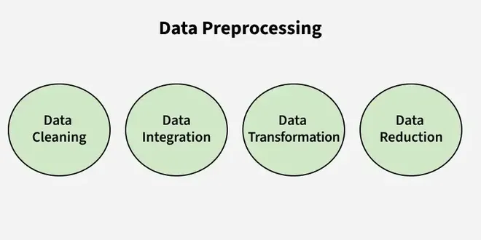
Data Preprocessing
Data preprocessing is the process of preparing raw data for analysis by cleaning and transforming it into a usable format. In data mining it refers to preparing raw data for mining by performing tasks like cleaning, transforming, and organizing it into a format suitable for mining algorithms.
Goal is to improve the quality of the data.
Helps in handling missing values, removing duplicates, and normalizing data.
Ensures the accuracy and consistency of the dataset.
Steps in Data Preprocessing
Some key steps in data preprocessing are Data Cleaning, Data Integration, Data Transformation, and Data Reduction.

Slide 13
1. Data Cleaning: It is the process of identifying and correcting errors or inconsistencies in the dataset. It involves handling missing values, removing duplicates, and correcting incorrect or outlier data to ensure the dataset is accurate and reliable. Clean data is essential for effective analysis, as it improves the quality of results and enhances the performance of data models.
Missing Values: This occur when data is absent from a dataset. You can either ignore the rows with missing data or fill the gaps manually, with the attribute mean, or by using the most probable value. This ensures the dataset remains accurate and complete for analysis.
Noisy Data: It refers to irrelevant or incorrect data that is difficult for machines to interpret, often caused by errors in data collection or entry. It can be handled in several ways:
Binning Method: The data is sorted into equal segments, and each segment is smoothed by replacing values with the mean or boundary values.
Regression: Data can be smoothed by fitting it to a regression function, either linear or multiple, to predict values.
Clustering: This method groups similar data points together, with outliers either being undetected or falling outside the clusters. These techniques help remove noise and improve data quality.
Removing Duplicates: It involves identifying and eliminating repeated data entries to ensure accuracy and consistency in the dataset. This process prevents errors and ensures reliable analysis by keeping only unique records.
Data Integration: It involves merging data from various sources into a single, unified dataset. It can be challenging due to differences in data formats, structures, and meanings. Techniques like record linkage and data fusion help in combining data efficiently, ensuring consistency and accuracy.
Record Linkage is the process of identifying and matching records from different datasets that refer to the same entity, even if they are represented differently. It helps in combining data from various sources by finding corresponding records based on common identifiers or attributes.
Data Fusion involves combining data from multiple sources to create a more comprehensive and accurate dataset. It integrates information that may be inconsistent or incomplete from different sources, ensuring a unified and richer dataset for analysis.

Slide 14
3. Data Transformation: It involves converting data into a format suitable for analysis. Common techniques include normalization, which scales data to a common range; standardization, which adjusts data to have zero mean and unit variance; and discretization, which converts continuous data into discrete categories. These techniques help prepare the data for more accurate analysis.
Data Normalization: The process of scaling data to a common range to ensure consistency across variables.
Discretization: Converting continuous data into discrete categories for easier analysis.
Data Aggregation: Combining multiple data points into a summary form, such as averages or totals, to simplify analysis.
Concept Hierarchy Generation: Organizing data into a hierarchy of concepts to provide a higher-level view for better understanding and analysis.
4. Data Reduction: It reduces the dataset's size while maintaining key information. This can be done through feature selection, which chooses the most relevant features, and feature extraction, which transforms the data into a lower-dimensional space while preserving important details. It uses various reduction techniques such as,
Dimensionality Reduction (e.g., Principal Component Analysis): A technique that reduces the number of variables in a dataset while retaining its essential information.
Numerosity Reduction: Reducing the number of data points by methods like sampling to simplify the dataset without losing critical patterns.
Data Compression: Reducing the size of data by encoding it in a more compact form, making it easier to store and process.

Slide 15
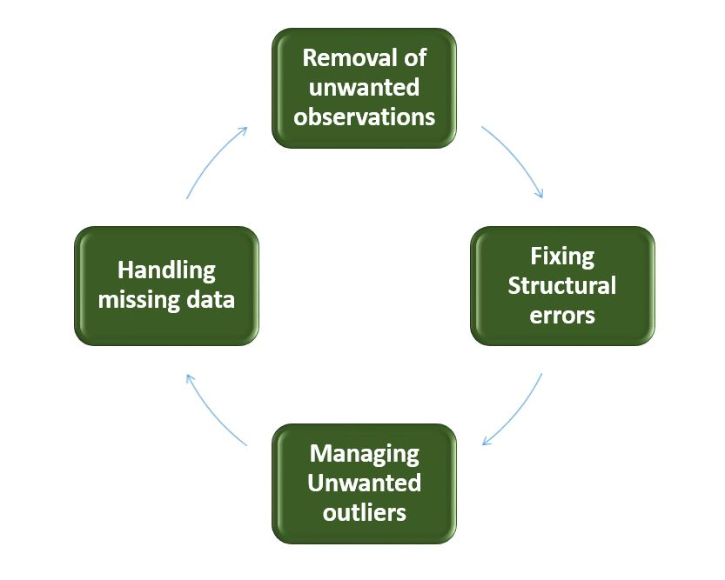
Data Cleaning
Data cleaning is a important step in the machine learning (ML) pipeline as it involves identifying and removing any missing duplicate or irrelevant data. The goal of data cleaning is to ensure that the data is accurate, consistent and free of errors as raw data is often noisy, incomplete and inconsistent which can negatively impact the accuracy of model and its reliability of insights derived from it. Professional data scientists usually invest a large portion of their time in this step because of the belief that Clean datasets also helps in EDA that enhance the interpretability of data so that right actions can be taken based on insights.
How to Perform Data Cleanliness?
The process begins by thorough understanding data and its structure to identify issues like missing values, duplicates and outliers. Performing data cleaning involves a systematic process to identify and remove errors in a dataset. The following are essential steps to perform data cleaning.

Slide 16
Removal of Unwanted Observations: Identify and remove irrelevant or redundant (unwanted) observations from the dataset. This step involves analyzing data entries for duplicate records, irrelevant information or data points that do not contribute to analysis and prediction. Removing them from dataset helps reducing noise and improving the overall quality of dataset.
Fixing Structure errors: Address structural issues in the dataset such as inconsistencies in data formats or variable types. Standardize formats ensure uniformity in data structure and hence data consistency.
Managing outliers: Outliers are those points that deviate significantly from dataset mean. Identifying and managing outliers significantly improve model accuracy as these extreme values influence analysis. Depending on the context decide whether to remove outliers or transform them to minimize their impact on analysis.
Handling Missing Data: To handle missing data effectively we need to impute missing values based on statistical methods, removing records with missing values or employing advanced imputation techniques. Handling missing data helps preventing biases and maintaining the integrity of data.
Python Implementation for Database Cleaning
Let's understand each step for Database Cleaning, using titanic dataset. Below are the necessary steps:
Import the necessary libraries
Load the dataset
Check the data information using df.info()
import pandas as pd
import numpy as np
import pandas as pd import numpy as np #Load the dataset df = pd.read_csv('titanic.csv') df.head()

Slide 17
Data Inspection and Exploration
Let's first understand the data by inspecting its structure and identifying missing values, outliers and inconsistencies and check the duplicate rows with below python code:
Check the data information using df.info()
Check the Categorical and Numerical Columns.
Check the total number of Unique Values in the Categorical Columns
df.duplicated()
df.info()
# Categorical columns cat_col = [col for col in df.columns if df[col].dtype == 'object'] print('Categorical columns :',cat_col) # Numerical columns num_col = [col for col in df.columns if df[col].dtype != 'object'] print('Numerical columns :',num_col)
df[cat_col].nunique()

Slide 18
Removal of all Above Unwanted Observations
Drop Name and Ticket Columns
Handling Missing Data
As we can see from the above result that Cabin has 77% null values and Age has 19.87% and Embarked has 0.22% of null values.
So, it's not a good idea to fill 77% of null values. So we will drop the Cabin column. Embarked column has only 0.22% of null values so, we drop the null values rows of Embarked column.
Imputing the missing values from past observations.
Again "missingness" is almost informative in itself and we should tell our algorithm if a value was missing.
Even if we build a model to impute our values we’re not adding any real information. we’re just reinforcing the patterns already provided by other features. We can use Mean imputation or Median imputations for the case.
df['Ticket'].unique()[:50]
df1 = df.drop(columns=['Name','Ticket']) df1.shape
round((df1.isnull().sum()/df1.shape[0])*100,2)
df2 = df1.drop(columns='Cabin') df2.dropna(subset=['Embarked'], axis=0, inplace=True) df2.shape
# Mean imputation df3 = df2.fillna(df2.Age.mean()) # Let's check the null values again df3.isnull().sum()

Slide 19
Handling Outliers
Outliers are extreme values that deviate significantly from the majority of the data. They can negatively impact the analysis and model performance. Techniques such as clustering, interpolation or transformation can be used to handle outliers.
To check the outliers we generally use a box plot. A box plot is a graphical representation of a dataset's distribution. It shows a variable's median, quartiles and potential outliers. The line inside the box denotes the median while the box itself denotes the interquartile range (IQR). The box plot extend to the most extreme non-outlier values within 1.5 times the IQR. Individual points beyond the box are considered potential outliers. A box plot offers an easy-to-understand overview of the range of the data and makes it possible to identify outliers or skewness in the distribution.
Let's plot the box plot for Age column data.
As we can see from the above Box and whisker plot, Our age dataset has outliers values. The values less than 5 and more than 55 are outliers.
import matplotlib.pyplot as plt plt.boxplot(df3['Age'], vert=False) plt.ylabel('Variable') plt.xlabel('Age') plt.title('Box Plot') plt.show()
# calculate summary statistics mean = df3['Age'].mean() std = df3['Age'].std() # Calculate the lower and upper bounds lower_bound = mean - std*2 upper_bound = mean + std*2 print('Lower Bound :',lower_bound) print('Upper Bound :',upper_bound) # Drop the outliers df4 = df3[(df3['Age'] >= lower_bound) & (df3['Age'] <= upper_bound)]

Slide 20
Data Transformation
Data transformation involves converting the data from one form to another to make it more suitable for analysis. Techniques such as normalization, scaling or encoding can be used to transform the data.
Data validation and verification
Data validation and verification involve ensuring that the data is accurate and consistent by comparing it with external sources or expert knowledge.
For the machine learning prediction we separate independent and target features. Here we will consider only 'Sex' 'Age' 'SibSp', 'Parch' 'Fare' 'Embarked' only as the independent features and Survived as target variables because PassengerId will not affect the survival rate.
Data formatting
Data formatting involves converting the data into a standard format or structure that can be easily processed by the algorithms or models used for analysis. Here we will discuss commonly used data formatting techniques i.e. Scaling and Normalization.
Scaling
Scaling involves transforming the values of features to a specific range. It maintains the shape of the original distribution while changing the scale.
Particularly useful when features have different scales, and certain algorithms are sensitive to the magnitude of the features.
Common scaling methods include Min-Max scaling and Standardization (Z-score scaling).
Min-Max Scaling: Min-Max scaling rescales the values to a specified range, typically between 0 and 1. It preserves the original distribution and ensures that the minimum value maps to 0 and the maximum value maps to 1.
X = df3[['Pclass','Sex','Age', 'SibSp','Parch','Fare','Embarked']] Y = df3['Survived']
from sklearn.preprocessing import MinMaxScaler # initialising the MinMaxScaler scaler = MinMaxScaler(feature_range=(0, 1)) # Numerical columns num_col_ = [col for col in X.columns if X[col].dtype != 'object'] x1 = X # learning the statistical parameters for each of the data and transforming x1[num_col_] = scaler.fit_transform(x1[num_col_]) x1.head()

Slide 21
Standardization (Z-score scaling): Standardization transforms the values to have a mean of 0 and a standard deviation of 1. It centers the data around the mean and scales it based on the standard deviation. Standardization makes the data more suitable for algorithms that assume a Gaussian distribution or require features to have zero mean and unit variance.
Z = (X - μ) / σ
Where,
X = Data
μ = Mean value of X
σ = Standard deviation of X

Slide 22
What is Normalization?
Normalization is a broad idea, and there are different ways to normalize data. Generally speaking, normalization refers to the process of adjusting values measured on different scales to a common scale. Sometime's, it's best to illustrate with an example. For each type of normalization below, we will consider a model to understand the relationship between the price of a house and its size.
Types of normalization
Let's look at some of the main types. Keep in mind, this is not a comprehensive list:
Min-max normalization
With min-max normalization, we might rescale the sizes of the houses to fit within a range of 0 to 1. This means that the smallest house size would be represented as 0, and the largest house size would be represented as 1.
Log normalization
Log normalization is another normalization technique. By using log normalization, we apply a logarithmic transformation to the house prices. This technique helps reduce the impact of larger prices, especially if there are significant differences between them.
Decimal scaling
Decimal scaling is another normailzation technique. For this example, we might adjust the sizes of the houses by shifting the decimal point to make the values smaller. This means that the house sizes are transformed to a more manageable scale while keeping their relative differences intact.
Mean normalization (mean-centering)
Mean normalization, in this context, would involve adjusting the house prices by subtracting the average price from each house's price. This process centers the prices at zero, showing how each house's size compares to the average. By doing this, we can analyze which house sizes are larger or smaller than average, making it easier to interpret their relative prices.
.

Slide 23
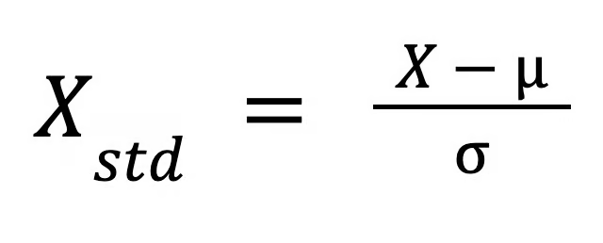
When should you normalize data?
As you may have inferred from the above examples, normalization is particularly useful when the distribution of the data is unknown or does not follow a Gaussian distribution. House prices are a good example here because some houses are very, very expensive, and models don’t always deal well with outliers.
So, the goal of normalization is to make a better model. We might normalize the dependent variable so the errors are more evenly distributed, or else we might normalize the input variables to ensure that features with larger scales do not dominate those with smaller scales.
Normalization is most effective in the following scenarios:
Unknown or Non-Gaussian Distribution: When the distribution of data is not known or does not follow a normal (Gaussian) pattern. For example in linear regression, we may want to normalize the dependent variable so it looks more like a bell curve, which allows for better confidence in our estimates.
Distance-Based Algorithms: Normalization is needed when using machine learning algorithms that rely on distances between data points, such as k-Nearest Neighbors (k-NN), to prevent features with larger scales from dominating the distance calculations.
What is Standardization?
While normalization scales features to a specific range, standardization, which is also called z-score scaling, transforms data to have a mean of 0 and a standard deviation of 1. This process adjusts the feature values by subtracting the mean and dividing by the standard deviation. You might have heard of ‘centering and scaling’ data. Well, standardization refers to the same thing: first centering, then scaling.
The formula for standardization is:

Slide 24
Where:
X is the original value,
mu is the mean of the feature, and
sigma is the standard deviation of the feature.
This formula rescales the data in such a way that its distribution has a mean of 0 and a standard deviation of 1.
When should you standardize data?
Standardization is most appropriate in the following cases:
Gradient-based Algorithms: Support Vector Machine (SVM) requires standardized data for optimal performance. While models like linear regression and logistic regression do not assume standardization, they may still benefit from it, particularly when features vary widely in magnitude, helping ensure balanced contributions from each feature and improving optimization.
Dimensionality Reduction: Standardization is in dimensionality reduction techniques like PCA(Principal Comonent Ana;ysis) because PCA identifies the direction where the variance in the data is maximized. Mean normalization alone is not sufficient because PCA considers both the mean and variance, and different feature scales would distort the analysis.

Slide 25
Normalization vs. Standardization: Key Differences
Sometimes, it’s difficult to distinguish between normalization and standardization. For one thing, normalization is sometimes used as a more general term, while standardization has a meaning that is a little more specific or specifically technical. Also, data analysts and data scientists who are familiar with the terms might still struggle to distinguish use cases.
While both are feature scaling techniques, they differ in their approaches and applications. Understanding these differences is key to choosing the right technique for your machine learning model.
Rescaling methods
Normalization rescales feature values within a predefined range, often between 0 and 1, which is particularly useful for models where the scale of features varies greatly. In contrast, standardization centers data around the mean (0) and scales it according to the standard deviation (1).
Sensitivity to outliers
Different normalization techniques vary in their effectiveness at handling outliers. Mean normalization can successfully adjust for outliers in some scenarios, but other techniques might not be as effective. In general, normalization techniques do not handle the outlier problem as effectively as standardization because standardization explicitly relies on both the mean and the standard deviation.
Use cases
Normalization is widely used in distance-based algorithms like k-Nearest Neighbors (k-NN), where features must be on the same scale to ensure accuracy in distance calculations. Standardization, on the other hand, is vital for gradient-based algorithms such as Support Vector Machines (SVM) and is frequently applied in dimensionality reduction techniques like PCA, where maintaining the correct feature variance is important.

Slide 26
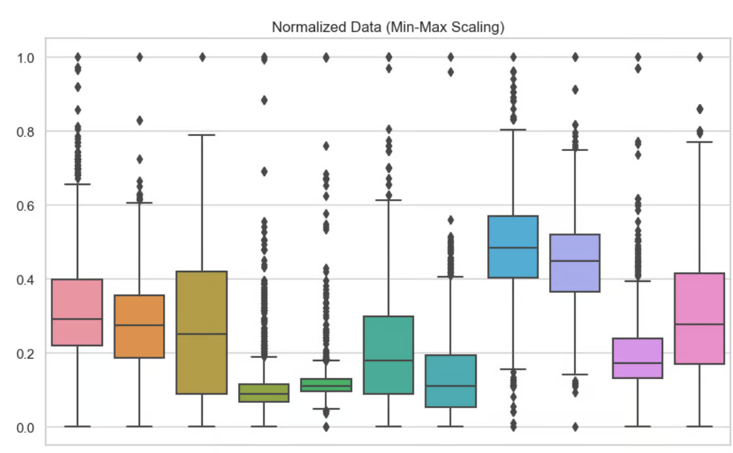
Visualizing the Differences
To understand the differences between normalization and standardization, it is helpful to see their effects visually and in terms of model performance. Here, I have included boxplots to show these different feature scaling techniques. Here, I have used min-max normalization on each of the variables in my dataset. We can see that no value is lower than 0 or bigger than 1.

Slide 27
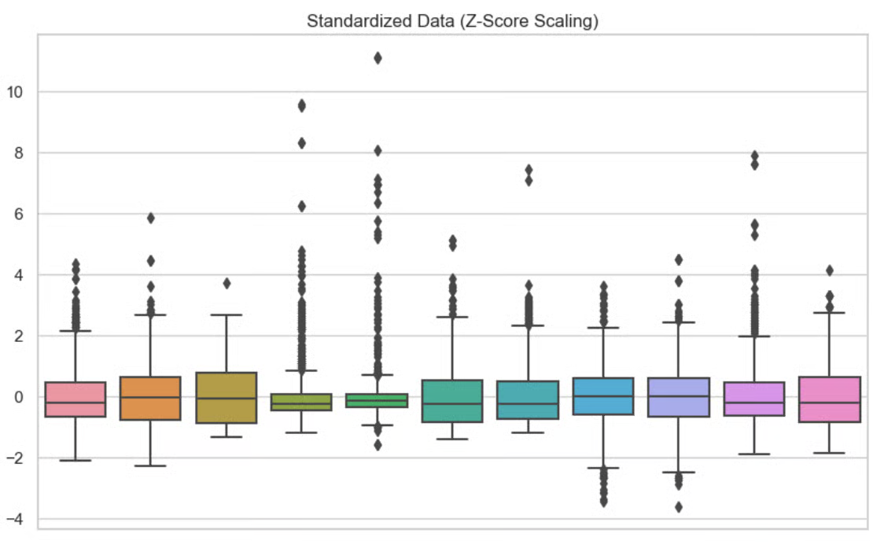
In this second visual, I have used standardization on each of the variables. We can see that the data is centered at zero.

Slide 28
Encoding categorical variable:
Data Encoding is an important pre-processing step in Machine Learning. It refers to the process of converting categorical or textual data into numerical format, so that it can be used as input for algorithms to process. The reason for encoding is that most machine learning algorithms work with numbers and not with text or categorical variables.
What is Categorical Data?
When we collect data, we often encounter different types of variables. One such type is categorical variables. Categorical variables are usually represented as ‘strings’ or ‘categories’ and are finite in number.
There are two types of categorical data -
• Ordinal Data
• Nominal Data
examples of categorical variables:
Places: Delhi, Mumbai, Ahmedabad, Bangalore, etc.
• Departments: Finance, Human resources, IT, Production.
• Grades: A, A-, B+, B, B- etc.

Slide 29
Ordinal Data:
The categories of ordinal data have an Inherent Order. This means that the categories can be Ranked or ordered from highest to lowest or vice versa.
For example, the variable “highest degree a person has” is an ordinal variable. The categories (High school, Diploma, Bachelors, Masters, PhD) can be ranked in order of the level of education attained.
Nominal Data:
The categories of nominal data do not have an Inherent Order. This means that the categories cannot be ranked or ordered.
For example, the variable “city where a person lives” is a nominal variable. The categories (Delhi, Mumbai, Ahmedabad, Bangalore, etc.) cannot be ranked or ordered.
What is Data Encoding?
Data Encoding is an important pre-processing step in Machine Learning. It refers to the process of converting categorical or textual data into numerical format, so that it can be used as input for algorithms to process. The reason for encoding is that most machine learning algorithms work with numbers and not with text or categorical variables.

Slide 30
Why it is Important?
• Most machine learning algorithms work only with numerical data, so categorical variables (such as text labels) must be transformed into numerical values.
• This allows the model to identify patterns in the data and make predictions based on those patterns.
• Encoding also helps to prevent bias in the model by ensuring that all features are equally weighted.
• The choice of encoding method can have a significant impact on model performance, so it is important to choose an appropriate encoding technique based on the nature of the data and the specific requirements of the model.
There are several methods for encoding categorical variables, including
1. One-Hot Encoding
2. Dummy Encoding
3.Ordinal Encoding
4. Binary Encoding
5. Count Encoding
6. Target Encoding

Slide 31
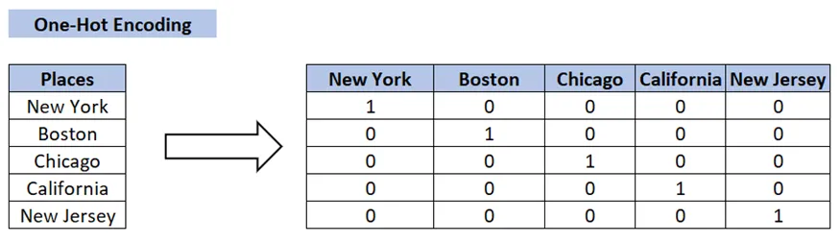
One-Hot Encoding:
• One-Hot Encoding is the Most Common method for encoding Categorical variables.
• a Binary Column is created for each Unique Category in the variable.
• If a category is present in a sample, the corresponding column is set to 1, and all other columns are setto0.
For example, if a variable has three categories ‘A’, ‘B’ and ‘C’, three columns will be created and a sample with category ‘B’ will have the value [0,1,0].
# One-Hot Encoding: # create a sample dataframe with a categorical variable df = pd.DataFrame({'color': ['red', 'green', 'blue', 'red']}) # perform one-hot encoding on the 'color' column one_hot = pd.get_dummies(df['color']) # concatenate the one-hot encoding with the original dataframe df1 = pd.concat([df, one_hot], axis=1) # drop the original 'color' column df1 = df1.drop('color', axis=1)

Slide 32
Data Reduction
Data reduction is a technique used in data mining to reduce the size of a dataset while still preserving the most important information. This can be beneficial in situations where the dataset is too large to be processed efficiently, or where the dataset contains a large amount of irrelevant or redundant information.
There are several different data reduction techniques that can be used in data mining, including:
Data Sampling: This technique involves selecting a subset of the data to work with, rather than using the entire dataset. This can be useful for reducing the size of a dataset while still preserving the overall trends and patterns in the data.
Dimensionality Reduction: This technique involves reducing the number of features in the dataset, either by removing features that are not relevant or by combining multiple features into a single feature.
Data Compression: This technique involves using techniques such as lossy or lossless compression to reduce the size of a dataset.
Data Discretization: This technique involves converting continuous data into discrete data by partitioning the range of possible values into intervals or bins.
Feature Selection: This technique involves selecting a subset of features from the dataset that are most relevant to the task at hand.
It's important to note that data reduction can have a trade-off between the accuracy and the size of the data. The more data is reduced, the less accurate the model will be and the less generalizable it will be.

Slide 33
Types of data reduction
Dimensionality reduction
The notion of data dimensionality underpins this entire concept. Dimensionality refers to the number of attributes (or features) assigned to a single dataset. However, there’s a tradeoff at work here—the greater the amount of dimensionality, the more data storage demanded by that dataset. Furthermore, the higher the dimensionality, the more often data tends to be sparse, complicating necessary outlier analysis.
Dimensionality reduction counters that by limiting the “noise” in the data and enabling better visualization of data. A prime example of dimensionality reduction is the wavelet transform method, which assists image compression by maintaining the relative distance that exists between objects at various resolution levels.
Feature extraction is another possible transformation for data—one that changes original data into numeric features and works in conjunction with machine learning. It differs from principal component analysis (PCA), another means of reducing the dimensionality of large data sets, in which a sizable set of variables is transformed into a smaller set while retaining most of the data from the large set.
Numerosity reduction
The other method involves selecting a smaller, less data-intensive format for representing data. There are two types of numerosity reduction—that which is based on parametric methods and that which is based on non-parametric methods. Parametric methods like regression concentrate on model parameters, to the exclusion of the data itself. Similarly, a log-linear model might be employed that focuses on subspaces within data. Meanwhile, non-parametric methods (like histograms, which show the way numerical data is distributed) don’t rely upon models at all.

Slide 34
Data cube aggregation
Data cubes are a visual way to store data. The term “data cube” is actually almost misleading in its implied singularity, because it’s really describing a large, multidimensional cube that’s composed of smaller, organized cuboids. Each of the cuboids represents some aspect of the total data within that data cube, specifically pieces of data concerning measurements and dimensions. Data cube aggregation, therefore, is the consolidation of data into the multidimensional cube visual format, which reduces data size by giving it a unique container specifically built for that purpose.
Data discretization
Another method enlisted for data reduction is data discretization, in which a linear set of data values is created based around a defined set of intervals that each correspond to a determined data value.
Data compression
In order to limit file size and achieve successful data compression, various types of encoding can be used. In general, data compression techniques are considered as either using lossless compression or lossy compression, and they are grouped according to those two types. In lossless compression, data size is reduced through encoding techniques and algorithms, and the complete original data can be restored if needed. Lossy compression, on the other hand, uses other methods to perform its compression, and although its processed data may be worth retaining, it will not be an exact copy, as you would get with lossless compression.
Data preprocessing
Some data needs to be cleaned, treated and processed before it undergoes the data analysis and data reduction processes. Part of that transformation may involve changing the data from analog in nature to digital. Binning is another example of data preprocessing, one in which median values are utilized to normalize various types of data and ensure data integrity across the board.

Slide 35
Uses of Data Preprocessing
Data preprocessing is utilized across various fields to ensure that raw data is transformed into a usable format for analysis and decision-making. Here are some key areas where data preprocessing is applied:
1. Data Warehousing: In data warehousing, preprocessing is essential for cleaning, integrating, and structuring data before it is stored in a centralized repository. This ensures the data is consistent and reliable for future queries and reporting.
2. Data Mining: Data preprocessing in data mining involves cleaning and transforming raw data to make it suitable for analysis. This step is crucial for identifying patterns and extracting insights from large datasets.
3. Machine Learning: In machine learning, preprocessing prepares raw data for model training. This includes handling missing values, normalizing features, encoding categorical variables, and splitting datasets into training and testing sets to improve model performance and accuracy.
4. Data Science: Data preprocessing is a fundamental step in data science projects, ensuring that the data used for analysis or building predictive models is clean, structured, and relevant. It enhances the overall quality of insights derived from the data.
5. Web Mining: In web mining, preprocessing helps analyze web usage logs to extract meaningful user behavior patterns. This can inform marketing strategies and improve user experience through personalized recommendations.
6. Business Intelligence (BI): Preprocessing supports BI by organizing and cleaning data to create dashboards and reports that provide actionable insights for decision-makers.
7. Deep Learning Purpose: Similar to machine learning, deep learning applications require preprocessing to normalize or enhance features of the input data, optimizing model training processes.

Slide 36
Advantages of Data Preprocessing
Improved Data Quality: Ensures data is clean, consistent, and reliable for analysis.
Better Model Performance: Reduces noise and irrelevant data, leading to more accurate predictions and insights.
Efficient Data Analysis: Streamlines data for faster and easier processing.
Enhanced Decision-Making: Provides clear and well-organized data for better business decisions.
Disadvantages of Data Preprocessing
Time-Consuming: Requires significant time and effort to clean, transform, and organize data.
Resource-Intensive: Demands computational power and skilled personnel for complex preprocessing tasks.
Potential Data Loss: Incorrect handling may result in losing valuable information.
Complexity: Handling large datasets or diverse formats can be challenging.

